Slide 1
Min-mean cycle cancelling algorithm
Zachary Sorenson, Connor Mattes

Slide 2
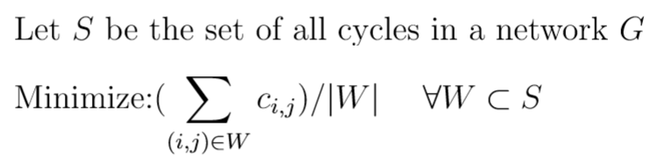
Min-mean cycle canceling formulation

Slide 3
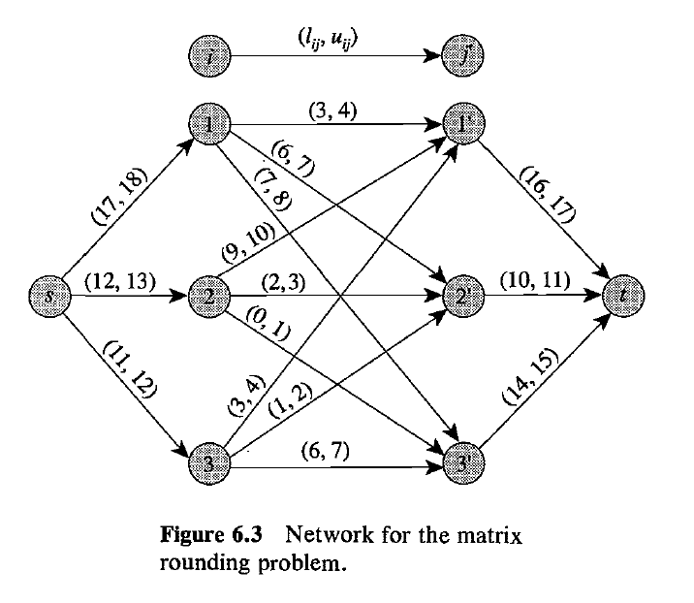
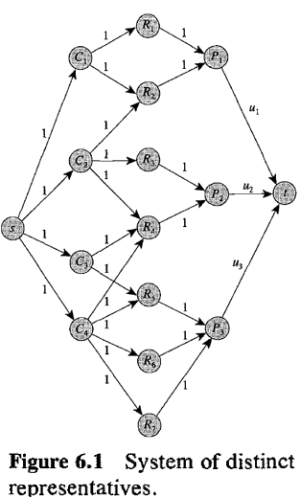
Maximum flow

Slide 4
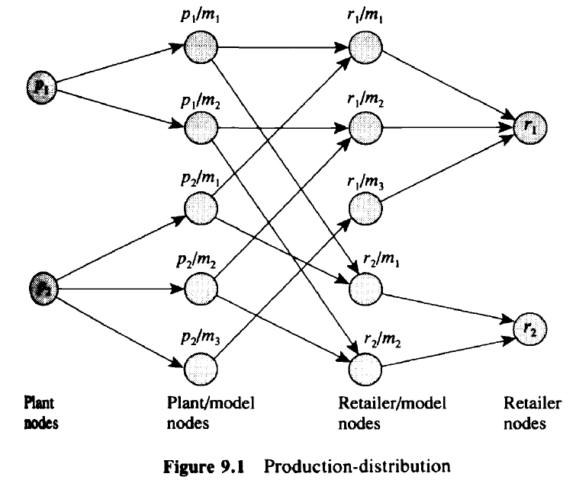
Min-Cost Flow

Slide 5
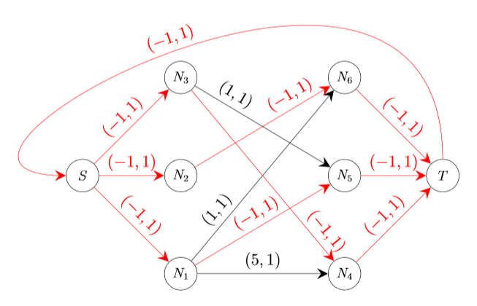
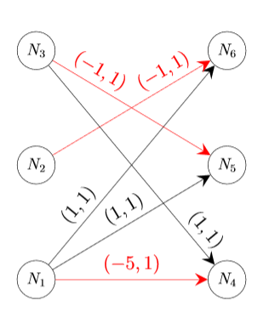
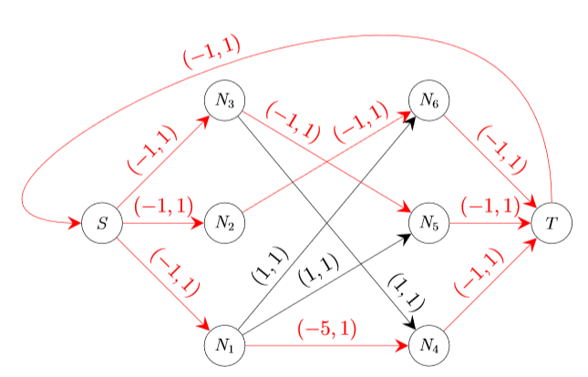
Matching Problem

Slide 6
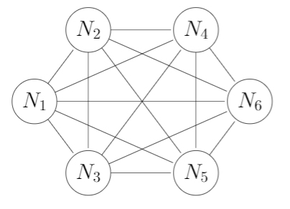
Traveling Salesmen problem

Slide 7
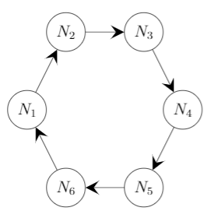
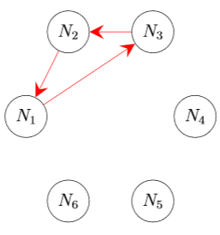
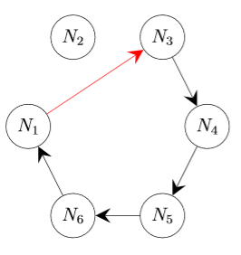
Traveling Salesmen Problem Extra Considerations

Slide 8
MIN Mean Cycle Cancelling
Optimality Condition: No negative cycles in residual network
Generic Cycle Cancelling Algorithm: Get rid of all cycles one at a time
Min mean cycle cancelling: Get rid of the “good” cycles first

Slide 9
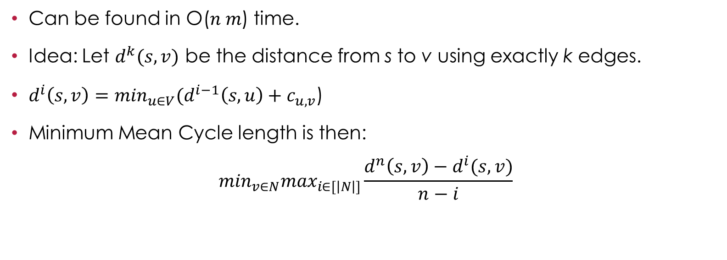
Finding Minimum Mean Cycles
Can be found in O($n m$) time.
Idea: Let $d^{k}(s,v)$ be the distance from s to v using exactly k edges.
$d^{i}\left(s,v\right)=\min_{u∈V}(d^{i−1}\left(s,u\right)+c_{u,v}$)
Minimum Mean Cycle length is then:
$$\min_{v∈N}\max_{i∈[\left|N\right|]}\frac{d^{n}\left(s,v\right)−d^{i}(s,v)}{n−i}$$

Slide 10
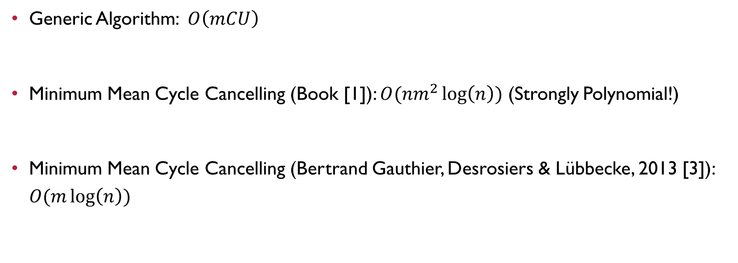
Number of Steps
Generic Algorithm: $O\left(mCU\right)$
Minimum Mean Cycle Cancelling (Book [1]): $O(nm^{2}\log\left(n\right))$ (Strongly Polynomial!)
Minimum Mean Cycle Cancelling (Bertrand Gauthier, Desrosiers & Lübbecke, 2013 [3]): $O(m\log\left(n\right))$

Slide 11
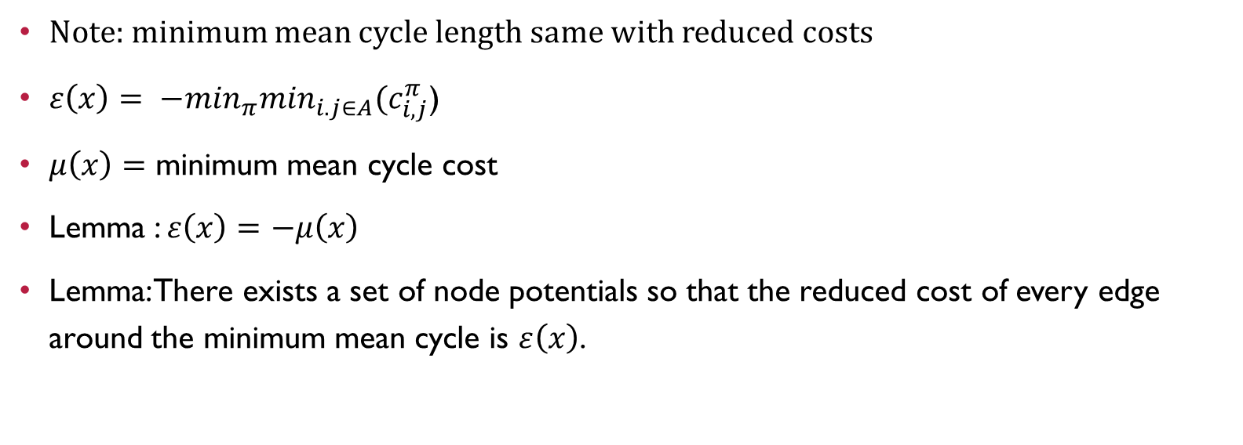
Structural Results
Note: minimum mean cycle length same with reduced costs
$ε\left(x\right)= {−min}_{π}\min_{i.j∈A}(c_{i,j}^{π}$)
$μ\left(x\right)=$ minimum mean cycle cost
Lemma : $ε\left(x\right)=$ $−μ\left(x\right)$
Lemma: There exists a set of node potentials so that the reduced cost of every edge around the minimum mean cycle is $ε\left(x\right)$.

Slide 12
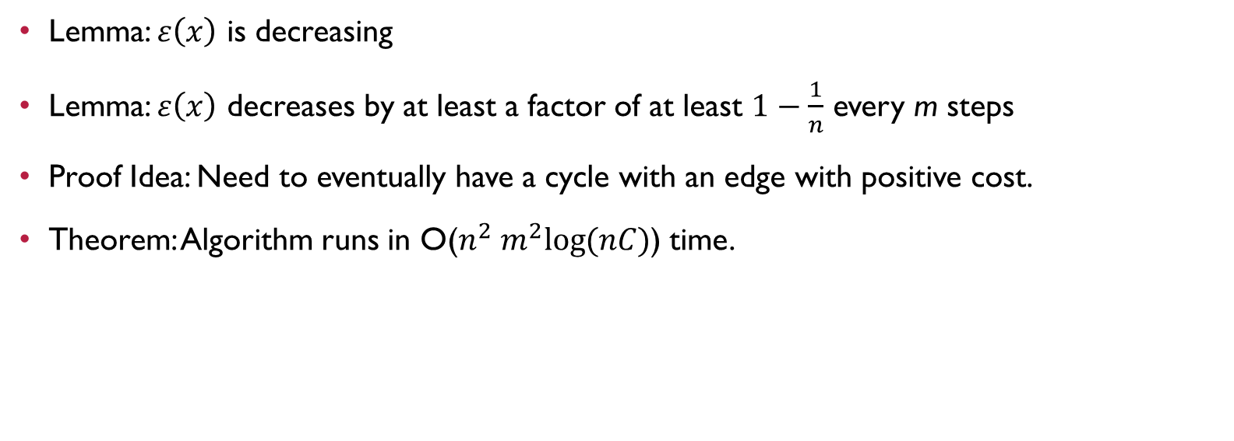
Weakly Polynomial Algorithm
Lemma: $ε\left(x\right)$ is decreasing
Lemma: $ε\left(x\right)$ decreases by at least a factor of at least $1−\frac{1}{n}$ every m steps
Proof Idea: Need to eventually have a cycle with an edge with positive cost.
Theorem: Algorithm runs in O($n^{2} m^{2}log⁡(nC)$) time.

Slide 13
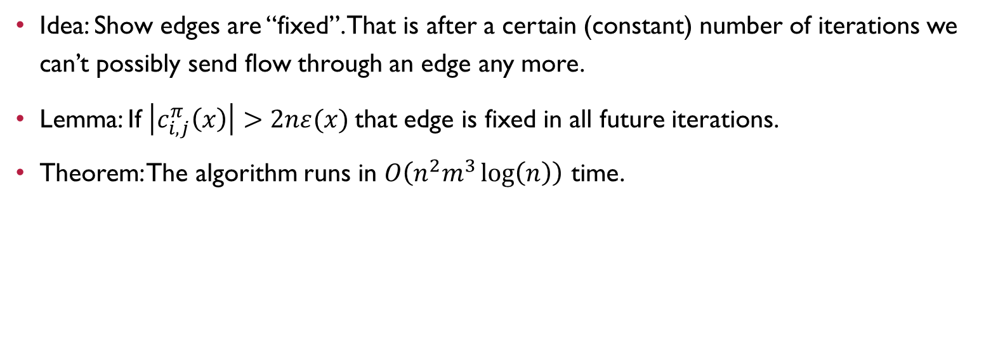
Strongly Polynomial Time Algorithm
Idea: Show edges are “fixed”. That is after a certain (constant) number of iterations we can’t possibly send flow through an edge any more.
Lemma: If $\left|c_{i,j}^{π}\left(x\right)\right|>2nε(x)$that edge is fixed in all future iterations.
Theorem: The algorithm runs in $O\left(n^{2}m^{3}\log\left(n\right)\right)$ time.

Slide 14
References
[1] R. Ahuja, T. Magnanti, J. Orlin; Network Flows
[2] R. Ahuja, J. Orlin: New Scaling Algorithms for the Assignment and Minimum mean Cycle Problems, Mathematical Programming (1992).
[3] J. Bertrand Gauthier, J. Desrosiers, M. E. Lübbecke; About the Minimum Mean Cycle-Canceling Algorithm, Discrete Applied Mathematics, (2013).
[4] R. Karp; A Characterization of the Minimum Cycle Mean in a Digraph, Discrete Mathematics (1978).

